Slide 1


Superstore Research
Student Details:
Name: Rohit Yadav
SkillsBuild Email ID: rohit24yadav102002@gmail.com
College Name: Vellore Institute of Technology, Chennai
College State: Tamil Nadu
Internship Domain and Internship Start Date: Data Analytics and 12-06-2023
Notes:
Hello Everyone, my Self Rohit Yadav pursuing my Btech degree in electronics and communication engineering specialisation in Vellore Institute of Technology.
Thanks to Edunet foundation and IBM skillsbuild for providing me with the opprotunity to present my analysis on Superstore data. IBM Skillsbuild has helped in understanding what all the things must be kept in mind while preparation and cleaning of data. They have given us given us am clear and concise idea about what all things must be kept in mind to create a informative visual

Slide 2

Project Topic
Analysis of
SUPERSTORE data
Problem Statement
To analyze and provide key insights about the SUPERSTORE data

Slide 3

AGENDA
Analyzing the data of a Superstore using Python, making visualizations for analyzing the Sales, Profit of the Superstore. Also understanding the Quantity and discount that is available at the Superstore. Descriptive analysis was done on the different categorical factors that include Category, Sub-Category, Region, City and State

Slide 4
Project Overview
This project aims to analyze superstore data to gain insights into sales, profitability, and customer behavior. By exploring the dataset, conducting descriptive analysis, customer segmentation, we seek to identify patterns, optimize pricing strategies, and provide actionable recommendations for improving business performance. The project will leverage data analysis techniques to unlock valuable insights and drive informed decision-making in the superstore domain.

Slide 5

Who are the
End Users
The analysis of superstore data project caters to business executives, sales/marketing teams, supply chain managers, pricing/revenue management teams, customer service teams, and data analysts/scientists, empowering them with actionable insights to drive strategic decisions, improve operations, optimize pricing, enhance customer experience, and maximize profitability.

Slide 6
Business Research & Analysis
Let us visit the important visualizations and the key insights from them

Slide 7
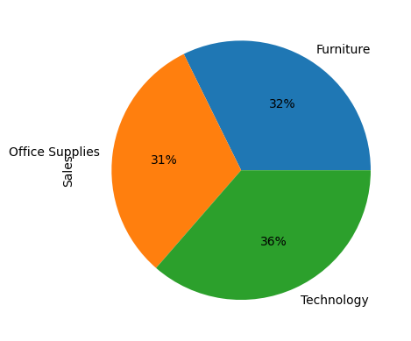

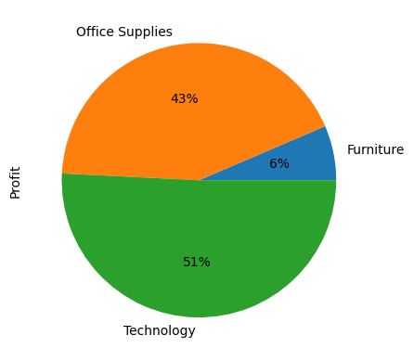

Sales and Profit by Category
First image represents the percentage of sales contributed by each category whereas second image represents the profit contribution
Key Insights:
Technology provide more profit compared to the other categories although all the categories has approx similar sales.
Furniture is category providing the most loss to the superstore

Slide 8
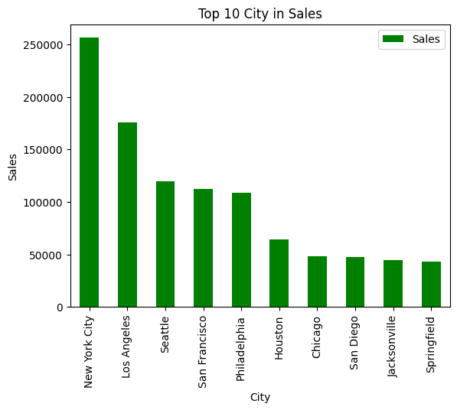
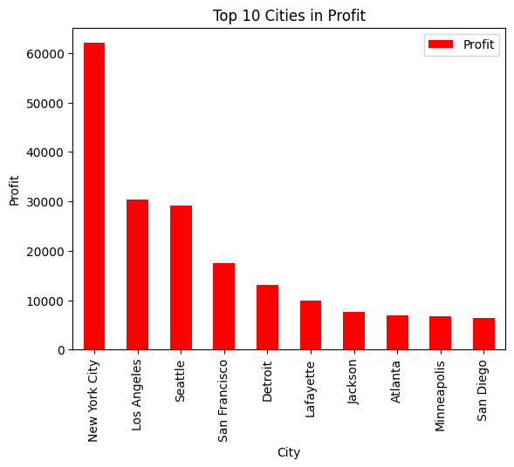
Top Cities in Sales and Profit
New York City provides the most sales and profit for the Superstore
followed by the Los Angles, Seattle and San Francisco.
Although Philadephia , Houston, Chicago provide high sales but they are not promising in the profit

Slide 9
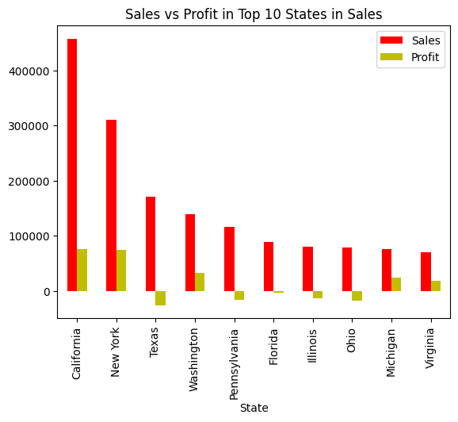
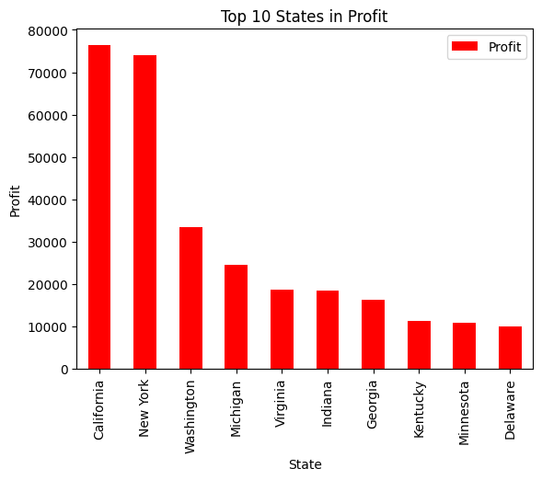
Top States in Profit and Sales
California, New York, Washington, Michingan and Virginia are the most promising states as they have high sales and do provide profit to the superstore
Texas and Pennsylvania are the states although have high sales but the profit here are less

Slide 10
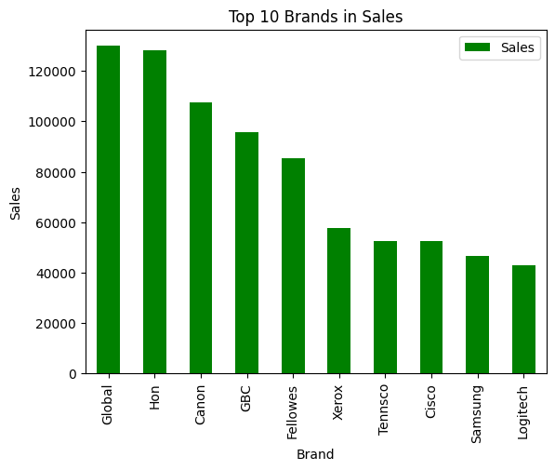
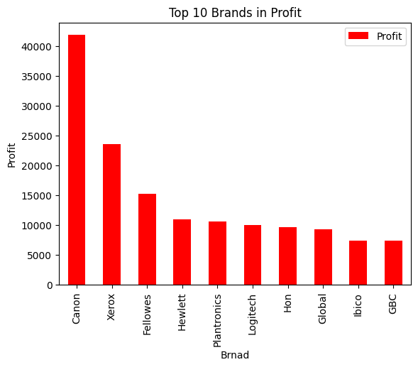
Top Brand in Sales and Profit
Although Global, Hon are the top in the sales of the superstore they are not able to provide the high profit compared to Canon, Xerox and Fellowes.
Xerox, Avery and the GBC brands have topped the quantity sold in the superstore

Slide 11
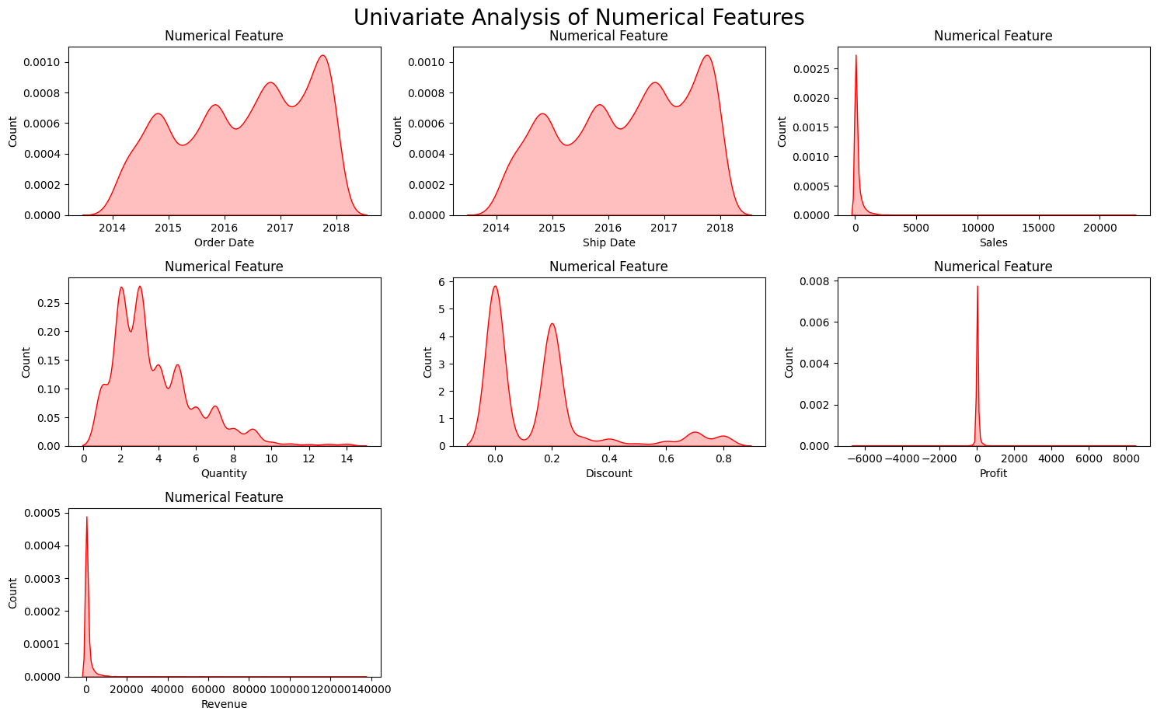

Slide 12
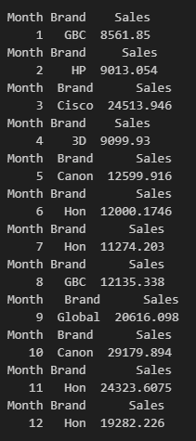
Top Brand in Sales in each Month
Table at the right shows which brand has made the highest sales in each Month.It can be seen that the Hon brand which has occupied the top position in maximum month (4 months).

Slide 13
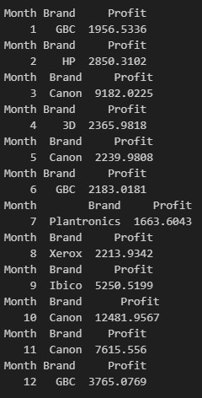
Top Brand in Profit in each Month
Tables in the right list out the name of the brand which has provided most profit in each month.
Canon has occupied the greatest number of months for providing the maximum profit to the superstore

Slide 14
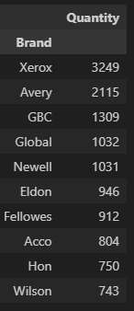
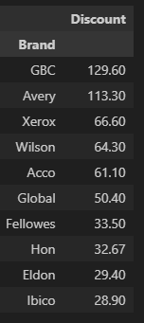
Quantity and Discount - Brand
Xerox brand was sold the most in 4 years (2014-2017), followed by Avery, GBC and global
More discount was provided in the brand GBC, Avery, Xerox and Wilson

Slide 15
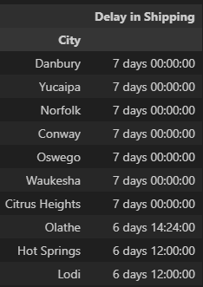
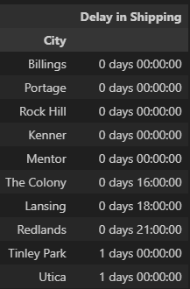
Delay in Shipping- City
Danbury, Yucaipa, Norfolk, Conway, Oswega, Waukesha and Citrus Heights are the cities where delivery is delayed from order date by a week
Bilings, Protage, Rock Hill, Kenner, Mentor, The Colony, Lansing and Redlands were the cities where shipping was done on the same day of the order dates

Slide 16
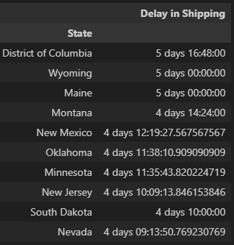
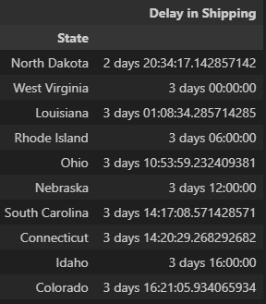
Delay in Shipping - STATES
District of Columbia, Wyoming and Maine are the states where the average delay for shipping is 5 days which is higst delay found.
North Dakota, West Virgini are the states where the average delay is found to be least

Slide 17

Results
In most cities delivery is delayed by a week our first task must be to lessen the delay for shipping
Although Hon brand has provided the most sales but they are not able to provide us with the huge profits. Strategy must be made so that profit can be increased from this brand

Slide 18
Results
Action must be taken to increase the profit received from the states like Texas because they provide high sales but are not efficient in providing huge profits.
Similar action must be taken to increase the profit received from the cities like Chicago, Houston and Philadelphia

Slide 19

Links
https://skillsbuild.edunetworld.com/courses/da/superstore/

Slide 20

Thank You For Your Attention
Notes:
Thank You Skillsbuild Platformand the edunet teamfor providing and supporting me throughout the project journey

